Slide 1
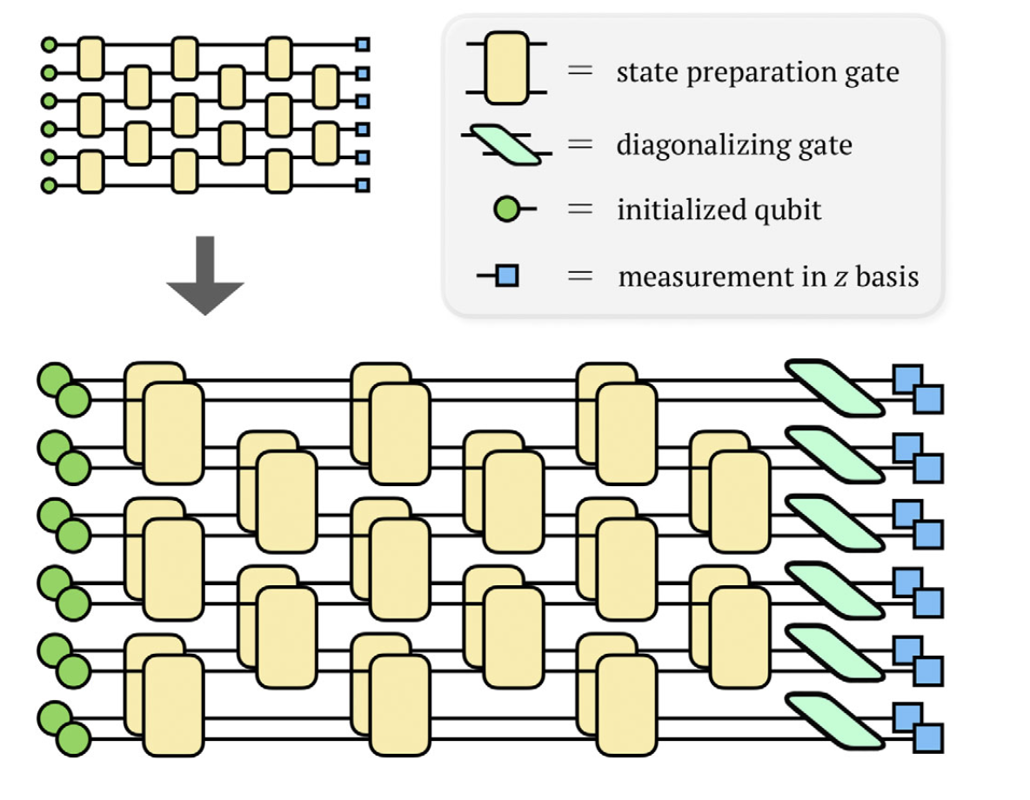
Implement virtual distillation, an error mitigation technique, in Qiskit
Error mitigation is vital to enhance the performance of NISQ devices.
We wish to mitigate incoherent noise with virtual distillation.
We use a variant, called dual state verification, which requires less connectivity.
Virtual Distillation:
requires connectivity between every copies.
The diagonalising gate can be challenging to implement in general.
Uses multiples copies to supress the non-dominating components exponentially fast.
Huggins, et al., Phys. Rev. X 11, 041036 (2021)

Slide 2
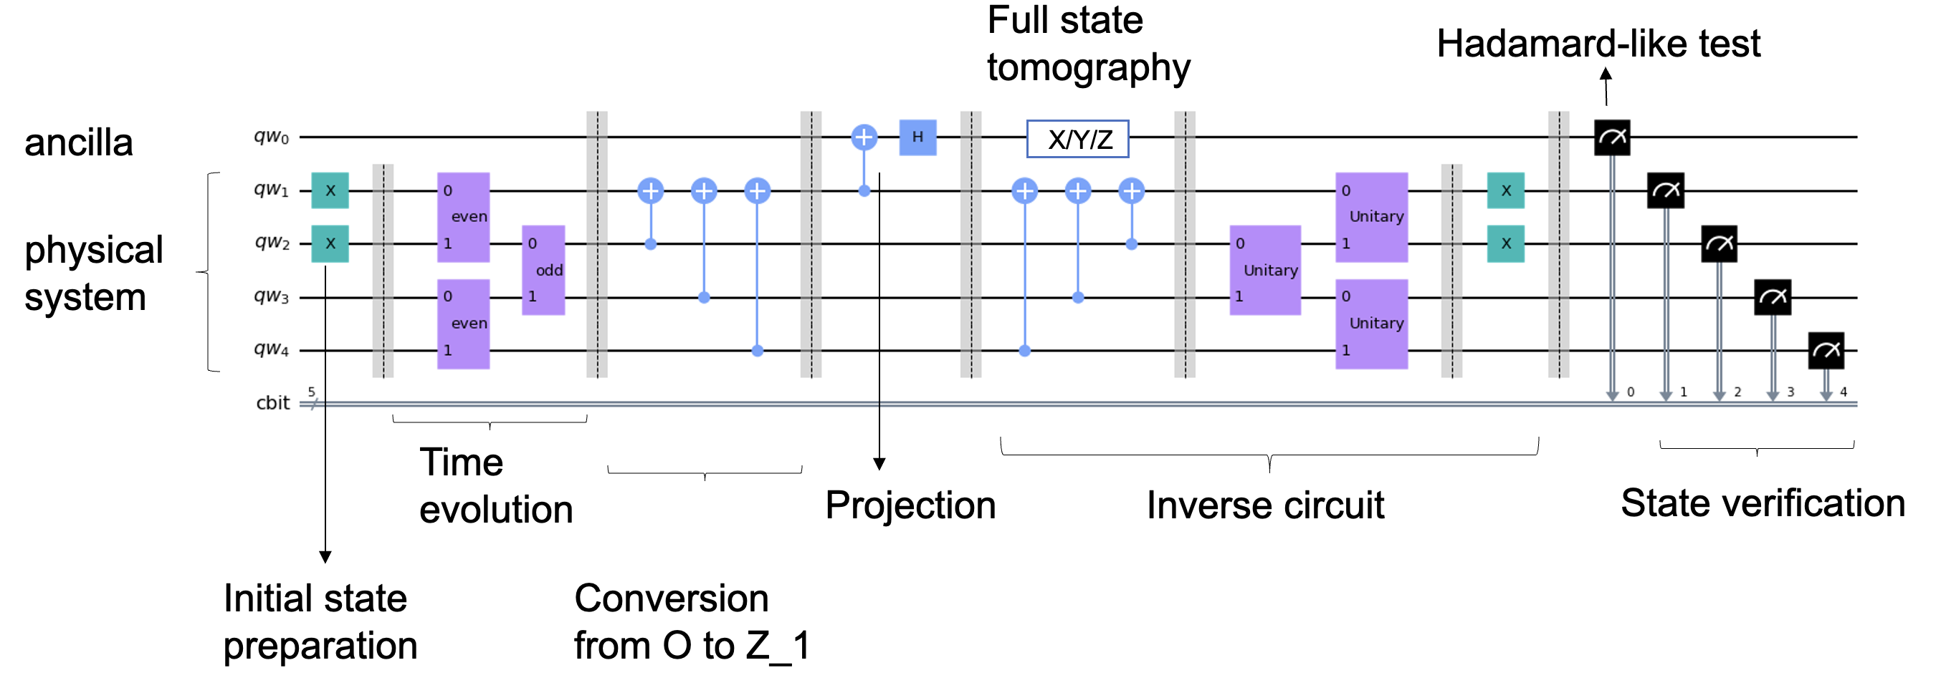
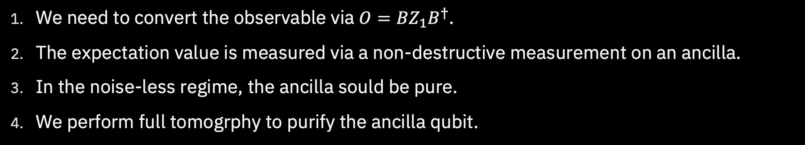
Dual State Verification
Mingxia Huo and Ying Li Phys. Rev. A 105, 022427 (2022)
We need to convert the observable via $O=BZ_{1}B^{†}$.
The expectation value is measured via a non-destructive measurement on an ancilla.
In the noise-less regime, the ancilla sould be pure.
We perform full tomogrphy to purify the ancilla qubit.

Slide 3
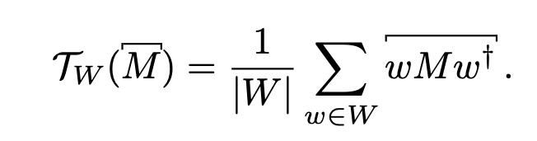
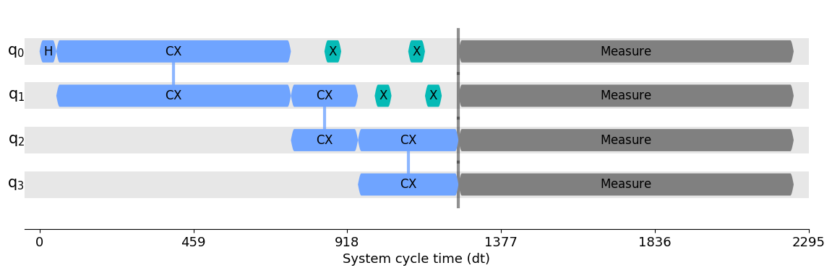
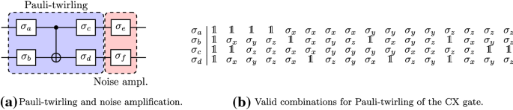
Improving Virtual Distillation? Turn coherent errors to incoherent ones!
Dynamical Decoupling
Pauli Twirling
Decrease decoherence by taking advantage of rapid, time-dependent control modulation when the qubits are idling.
Turn a noisy operator into a Pauli channel, via gate conjugation.
Which pulses sequences should we use?
(XY8)
Fuchs, et al., Eur. Phys. J. Plus 135, 353 (2020)

Slide 4
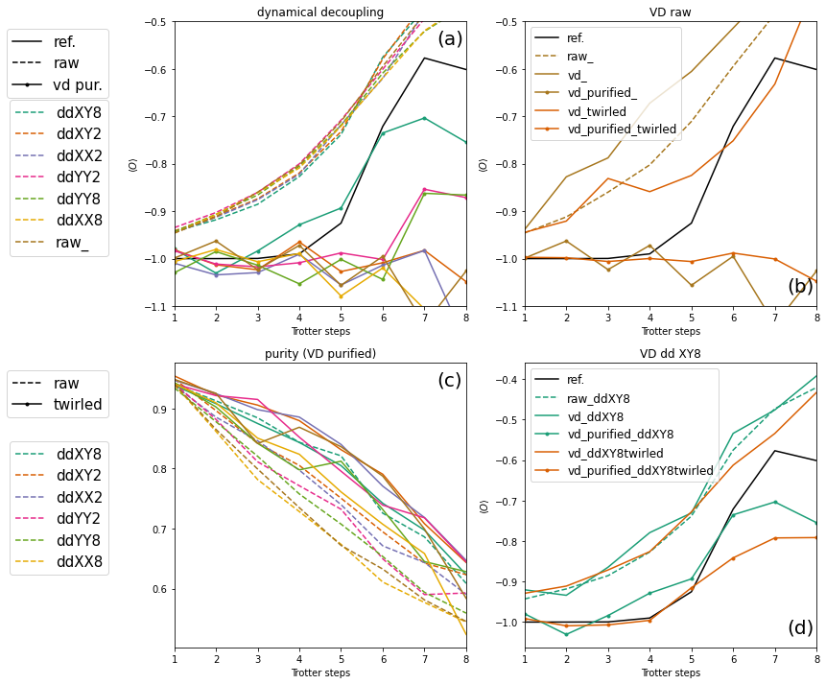

Experiment (IBMQ_mumbai)
VD alone is not sufficient (needs purification).
XY8 DD helps.
Twirling improves the purity.
XY8 DD + Twirling + purified VD is the best.

Slide 5
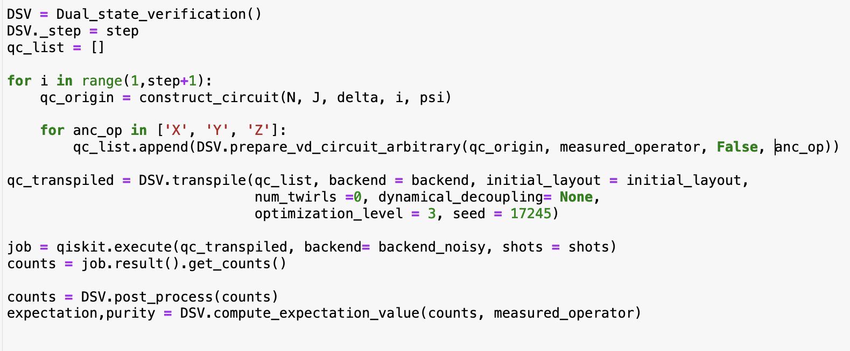
Software demonstration
Link to the repo
Inputs:
construct_circuit(params): prepare your circuits
measured_operator: pauli_string to be measured
psi: initial state
Outputs:
Expectation value at each Trotter step for the raw, DSV and DSV purified circuits.
Purity of the ancilla qubit.

